Slide 1
Lecture 2

Slide 2
TYPES OF MEASURING SYSTEMS:
English
Feet and Inches
Metric
Meters and Millimeters

Slide 3
Standard line types
- The various different looking lines used on technical or engineering drawings. Each style of line has a standard name, line thickness, pattern and meaning it conveys when used correctly. These lines are endorsed by both the ASME and ISO standards with minor variations.

Slide 4
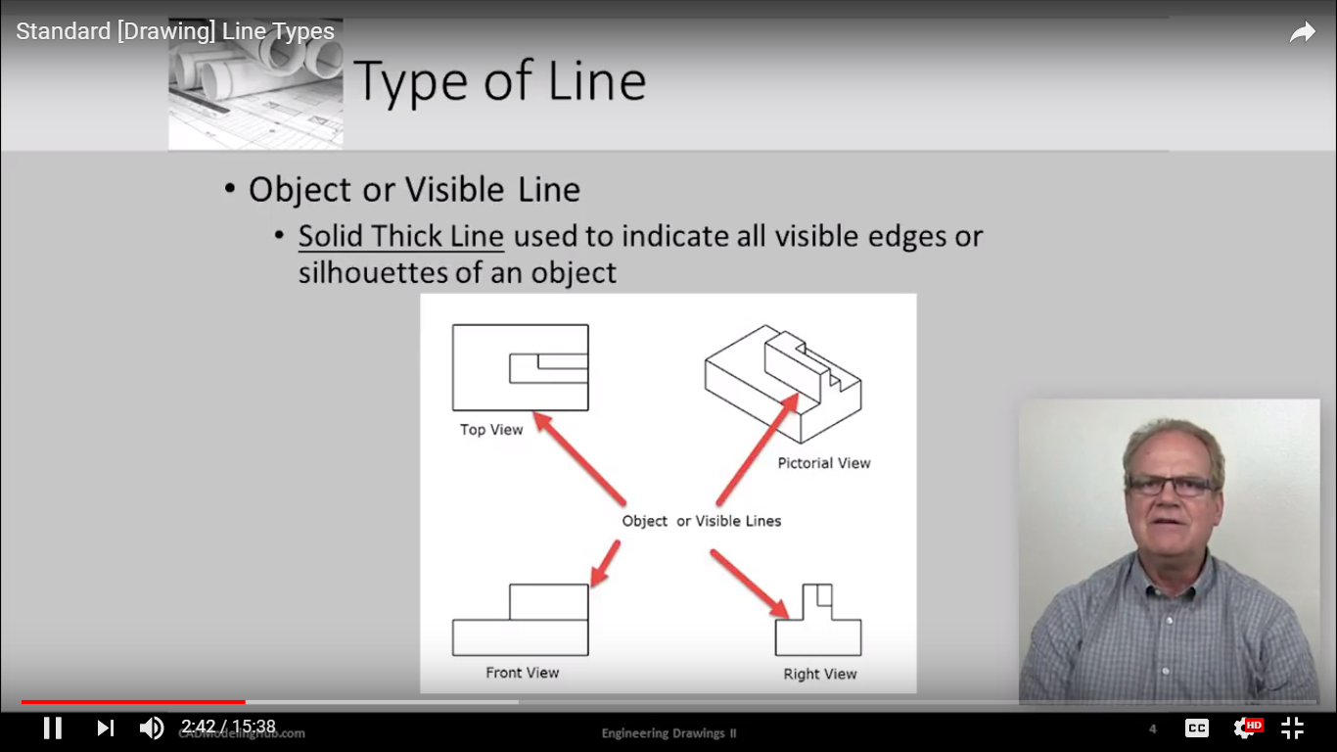
Object/visible line
Solid thick line Used to indicate visible object in a view.

Slide 5
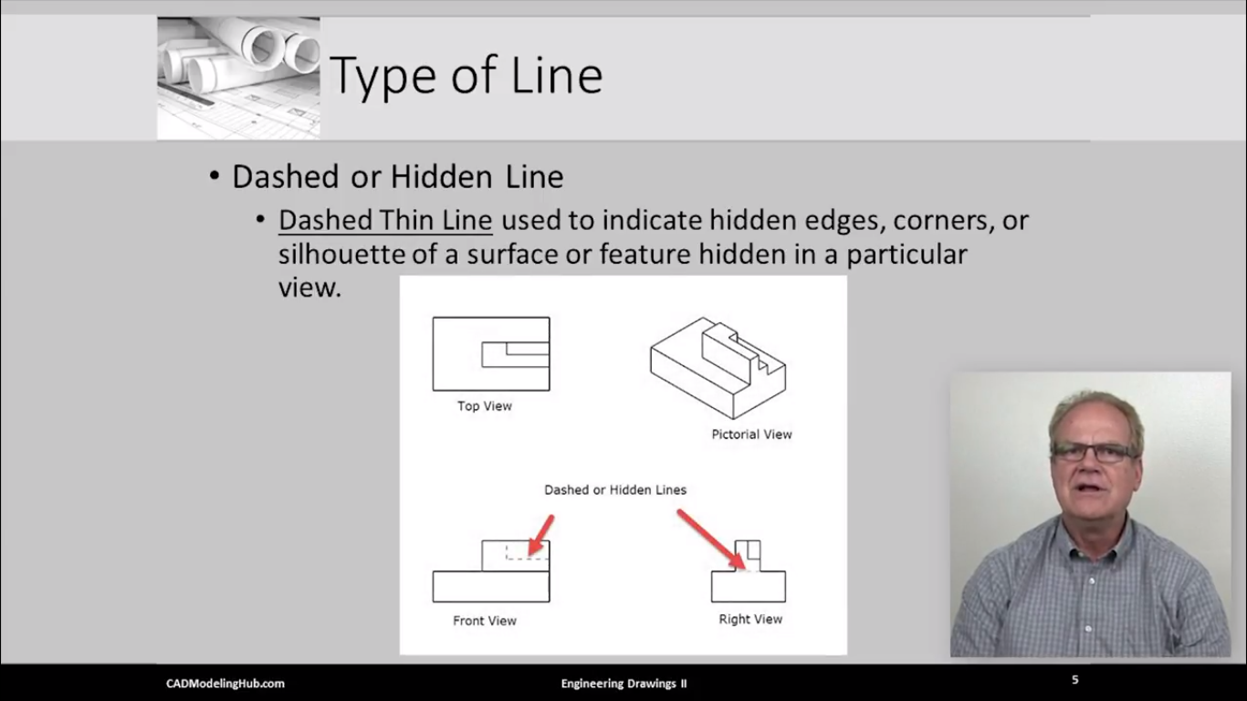
Hidden/Dashed line
Dashed Thin Line
Used to indicate hidden edges, corners hidden in a particular view

Slide 6
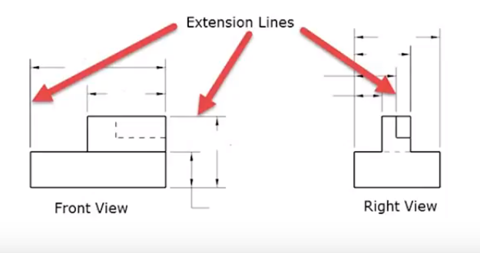
Extension line
Thin Line
Used to extend the edge, face or corner of a geometric feature.

Slide 7
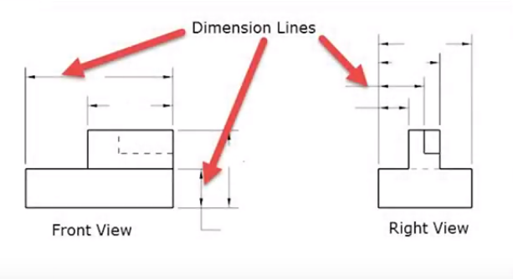
Dimension line
Thin line with arrows
Used to indicate the size or location of the geometric feature

Slide 8
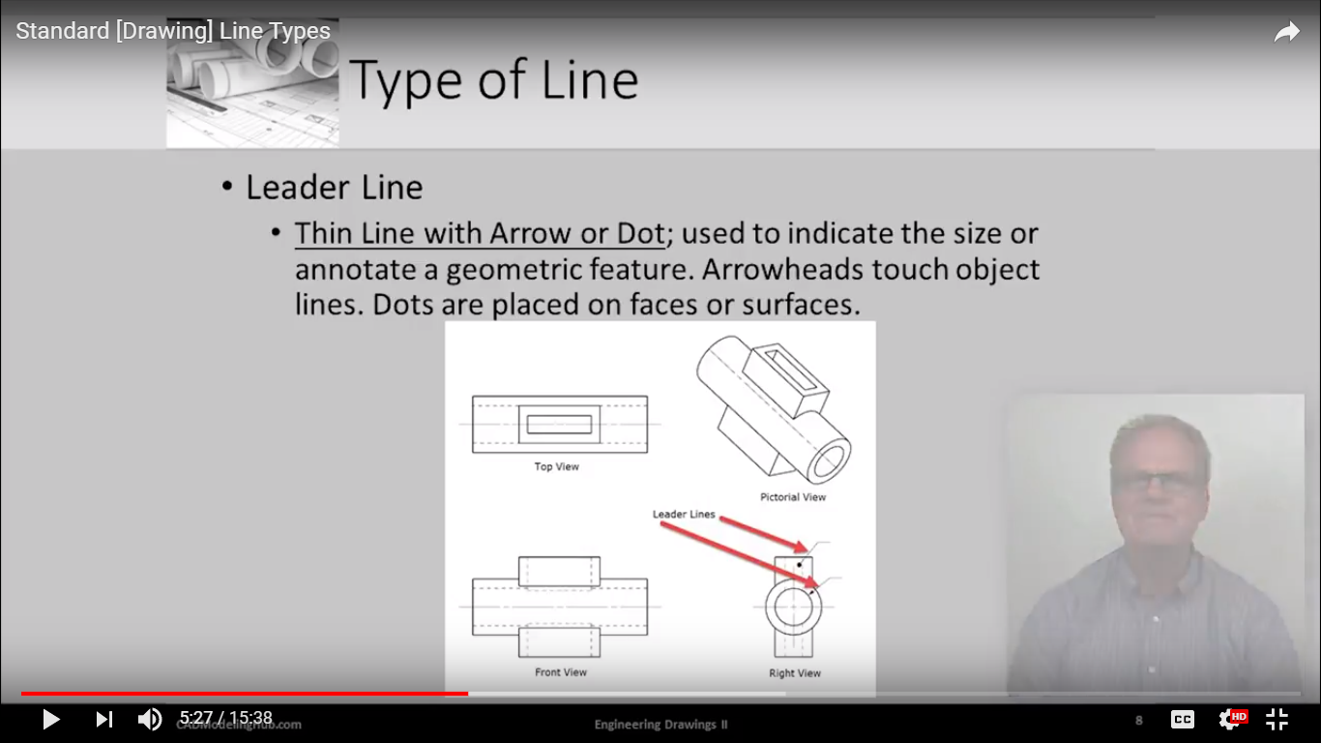
Leader line
Thin line with arrow or dot
Used to indicate the size of geometric feature
Arrowheads touch object lines
Dots are placed on faces or surfaces

Slide 9
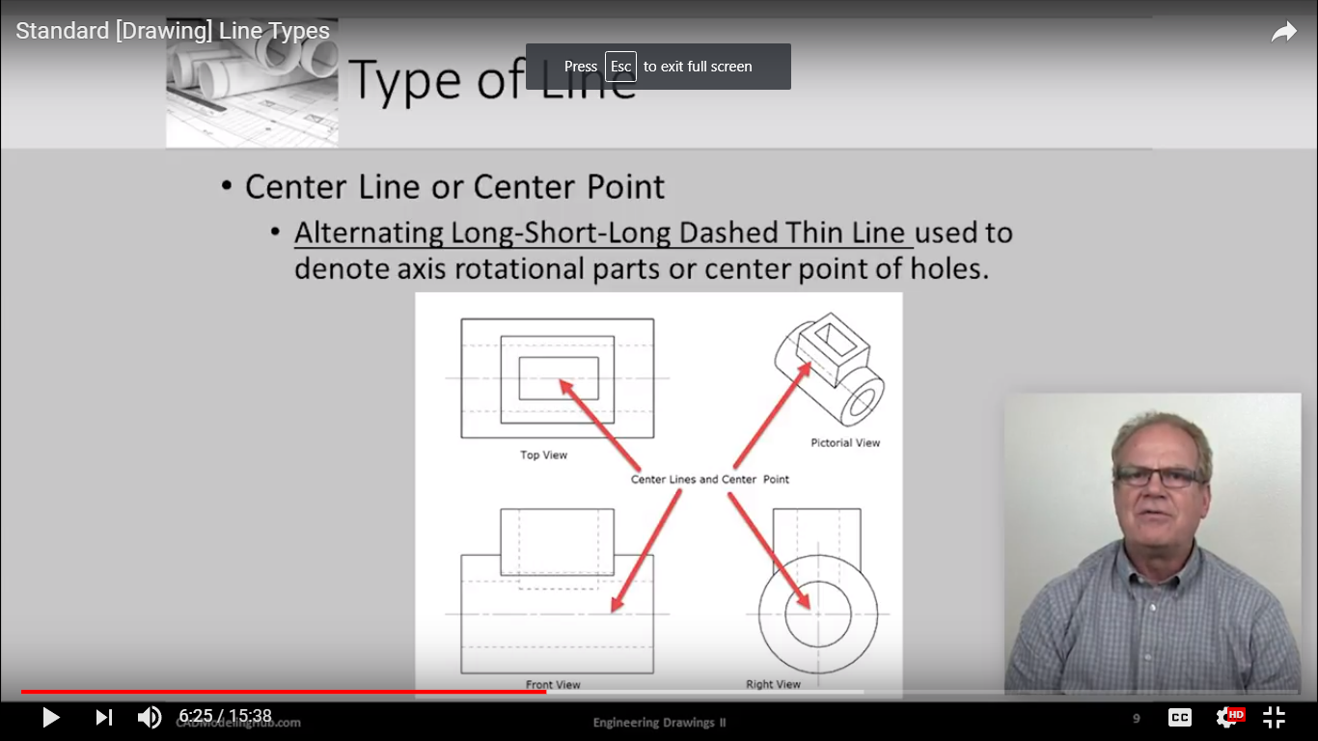
Centerline/center point
Alternating long-short-long dashed thin line
Used to denote the axis of rotational parts or center point of holes

Slide 10
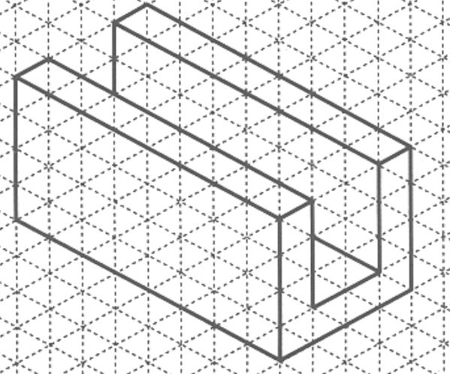
Task-1

Slide 11
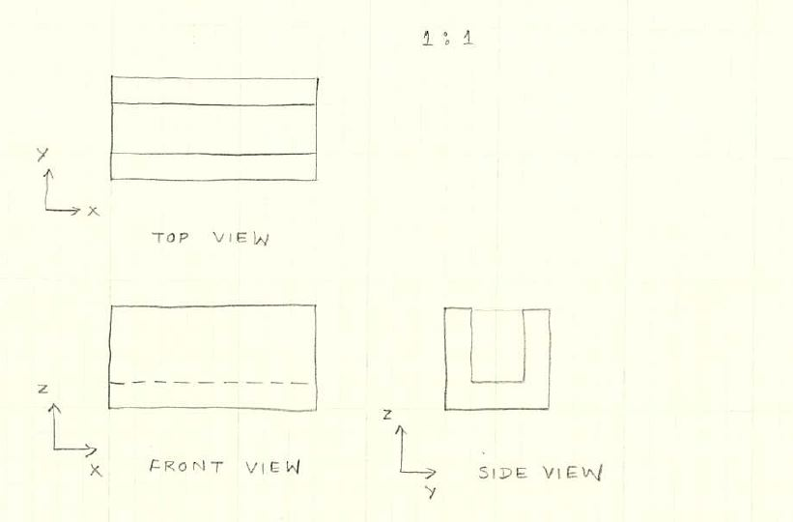
Solution

Slide 12
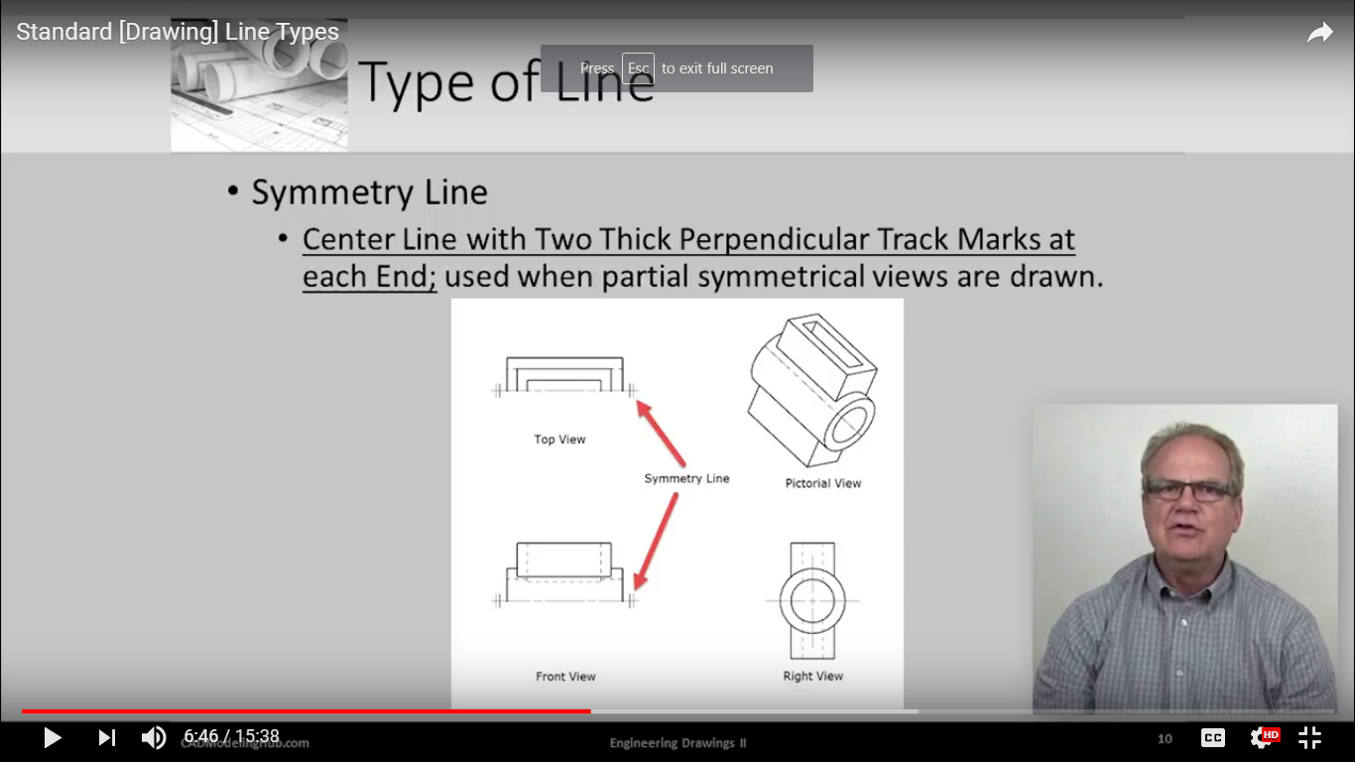
Symmetry lines
Centerline with 2 thick perpendicular track marks at each end
Used when partial symmetrical views are drawn

Slide 13
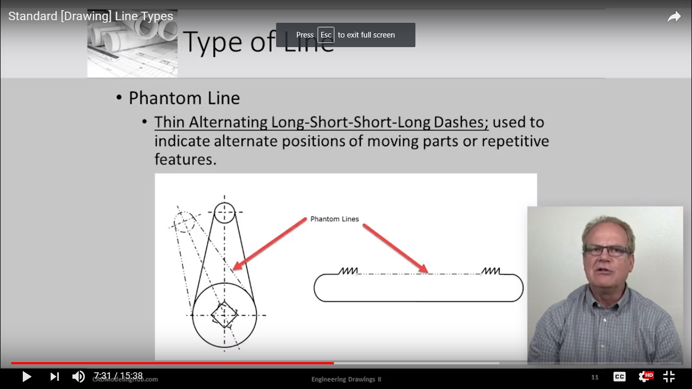
Phantom line
Thin alternating long-short-short-long dashes
Used to indicate alternate positions of moving parts or repetitive features

Slide 14
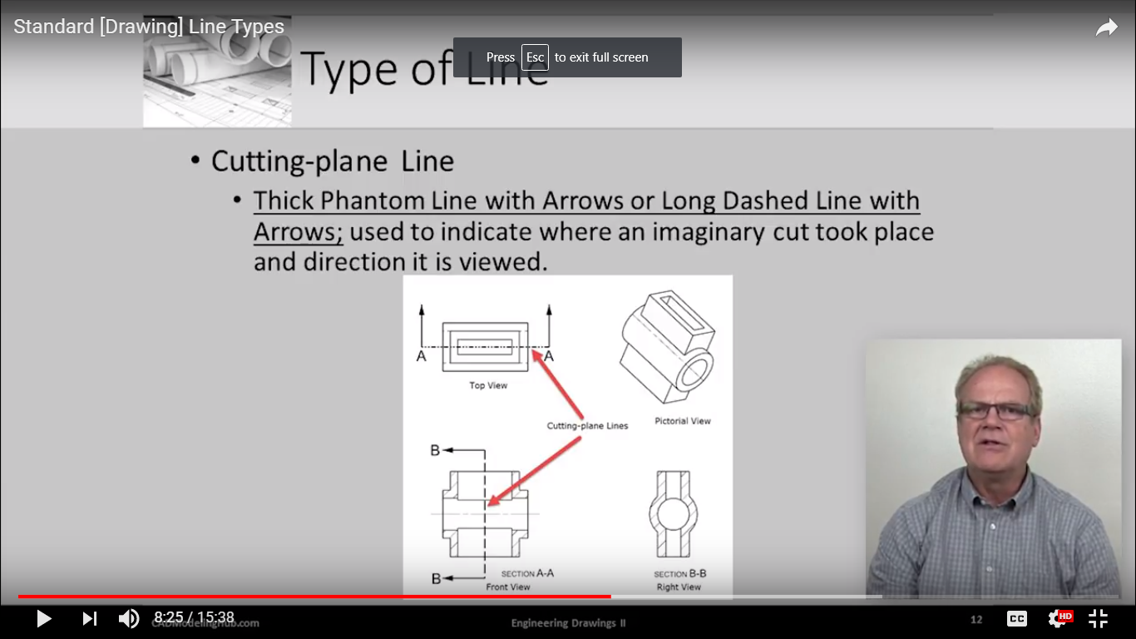
Cutting plane line
Thick phantom line with arrows or long dashed line with arrows
Used to indicate where an imaginary cut took place and direction it is viewed

Slide 15
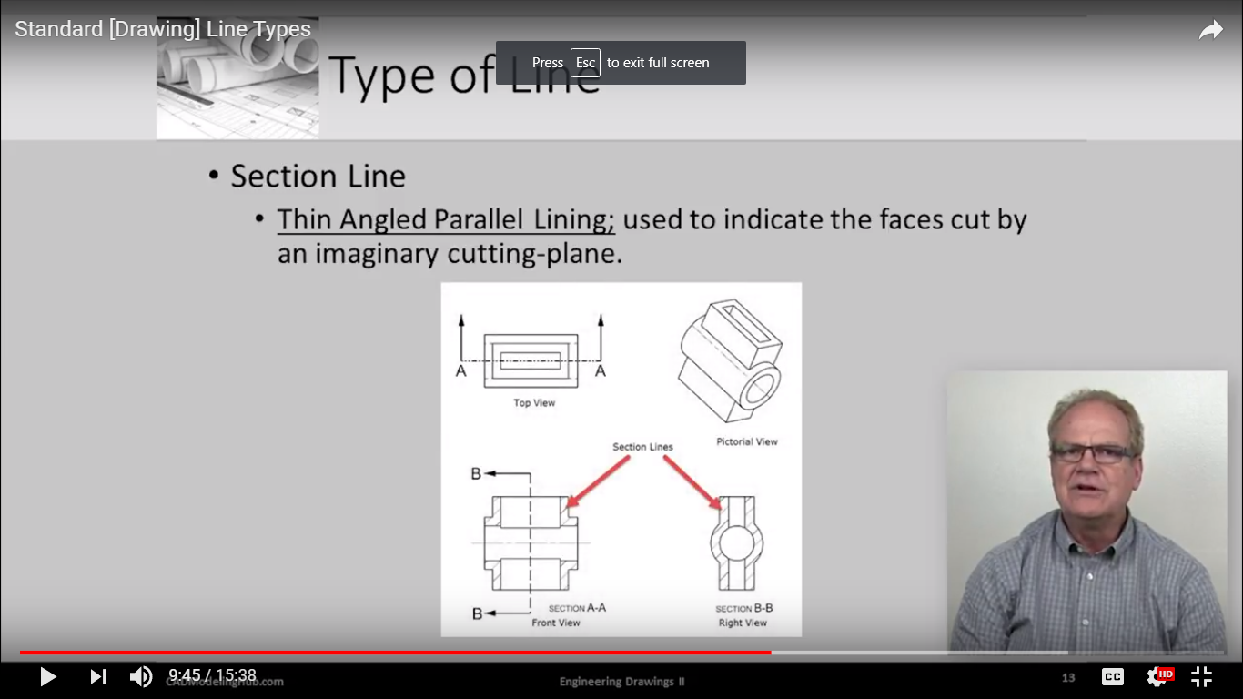
Section line/cross-hatching
Thin angled parallel lining
Used to indicate the faces cut by an imaginary cutting plane

Slide 16
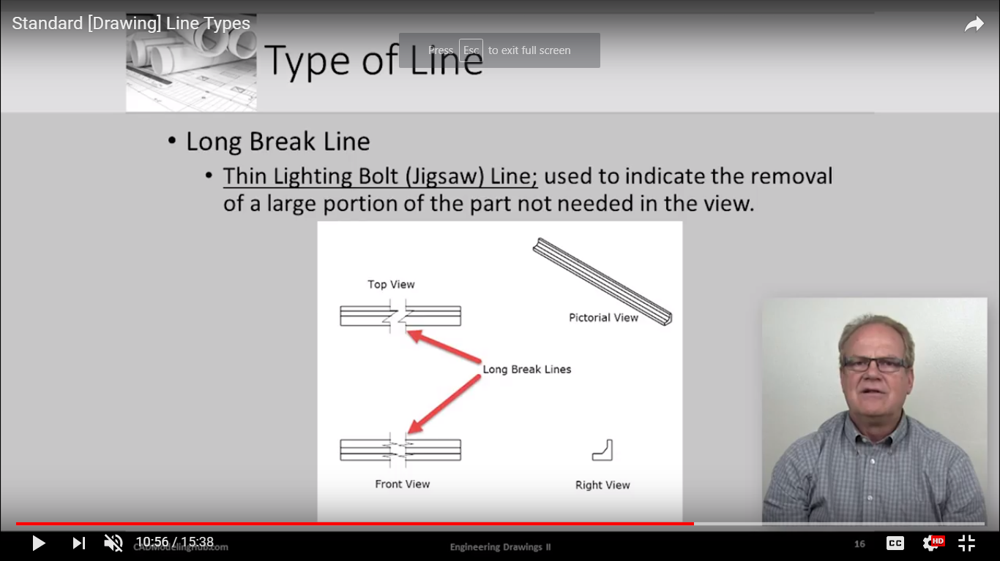
Break line
Thin lighting bolt line
Used to indicate the removal of a large portion of the part not needed in the view

Slide 17
Choose line widths according to the size of the drawing from the following range: 0.13,0.18, 0.25, 0.35, 0.5, 0.7 and 1 mm.
BIS recommends two line widths on a drawing.
Ratio between the thin and thick lines on a drawing shall not be less than 1 : 2.

Slide 18
When a Visible Line coincide with a Hidden Line or Center Line, draw the Visible Line. Also, extend the Center Line beyond the outlines of the view.
When a Hidden Line coincides with a Center Line, draw the Hidden Line.
When a Visible Line coincides with a Cutting Plane, draw the Visible Line.
When a Center line coincides with a Cutting Plane, draw the Center Line and show the Cutting Plane line outside the outlines of the view at the ends of the Center Line by thick dashes.

Slide 19
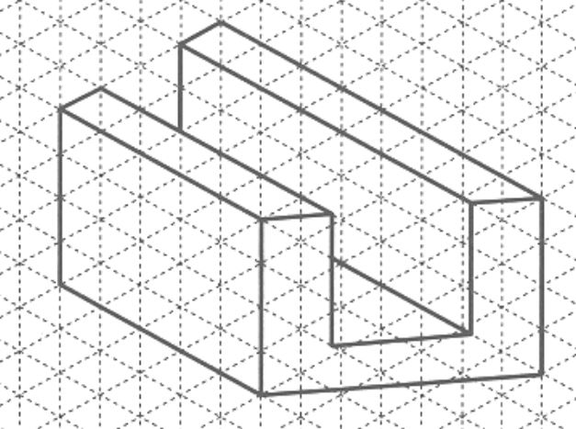
Task-2

Slide 20
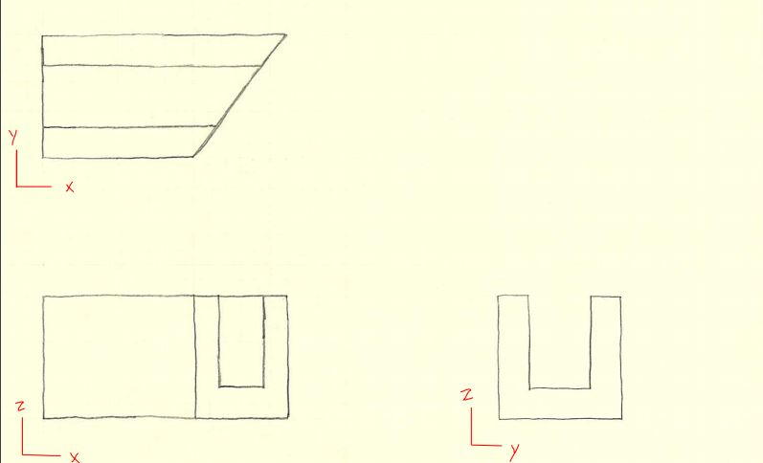
Solution

Slide 21
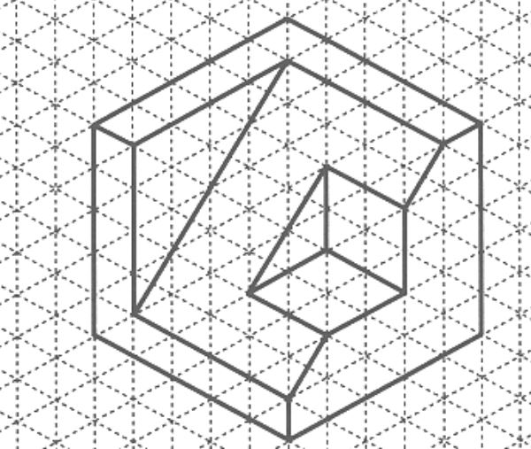
Task-3

